Slide 1

FreeRTOS-Based Smart Energy Monitoring and Billing System
EE-423 Embedded Systems Design (Dr. Wajid mumtaz)
Team Members:
  Awais Asghar (427265)
  Muhammad Haris (417629)
  Saad Farooq (418794)
  Aneeq Ur Rehman (422095)

Slide 2
Table of Contents
Problem Statement
Proposed Solution
Block Diagram
Methodology
Calculations
Code Implementation
Tools and Technologies
Project Hardware
Results
Applications
Team Contributions
Key Learnings
Conclusion
Acknowledgment & References

Slide 3
Problem Statement
Manual electricity monitoring is inefficient and error-prone
No real-time visibility of power consumption
Traditional meters do not provide cloud access or billing estimation
Need for a low-cost embedded solution for real-time energy monitoring

Slide 4
Proposed Solution
A real-time embedded energy monitoring system using STM32F746
Voltage and current sensing with RMS computation
ESP32 uploads live data to the cloud
Automatic energy (kWh) and bill calculation

Slide 5
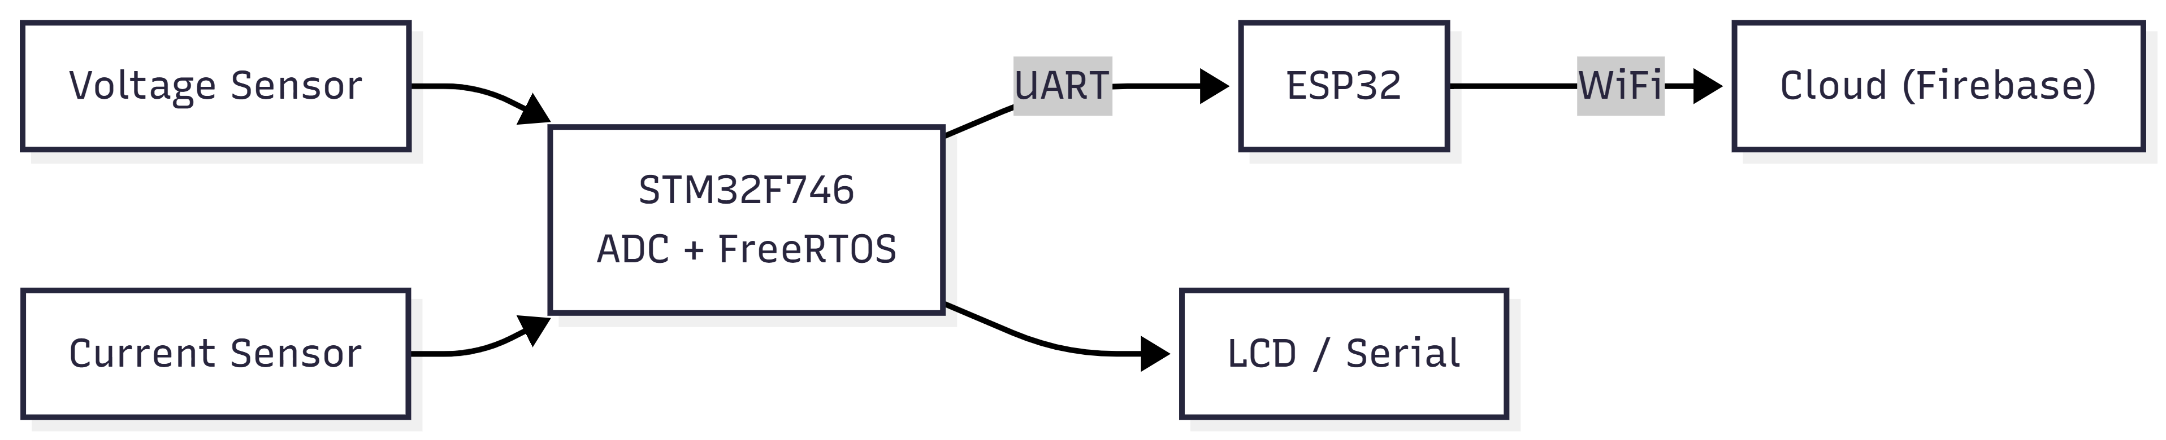
Block Diagram

Slide 6
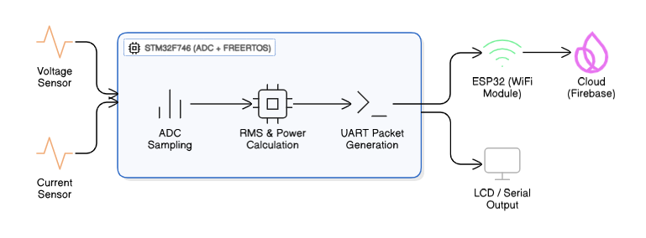
Methodology

Slide 7


Calculations
RMS Voltage: $V_{rms}=\sqrt{\frac{1}{N}∑{\left(v_{i}−\overset{‾}{v}\right)}^{2}}$
RMS Current: $I_{\text{rms}}=\sqrt{\frac{1}{N}\sum_{n=1}^{N}{{\left(i_{n}−\overset{‾}{i}\right)}^{2}}}$
Power: $P=V_{rms}×I_{rms}×PF$
Energy: $Energy\left(kWh\right)=\frac{P×t}{1000}$
Bill: $Bill=Energy×CostPerUnit$

Slide 8
Code Implementation
ADC sampling and RMS calculation (STM32)
UART packet formatting
ESP32 UART parsing
Energy and billing calculation
Firebase cloud upload

Slide 9
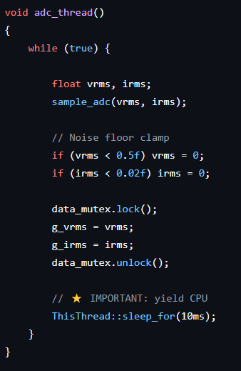
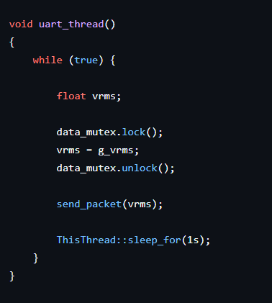
STM Code

Slide 10
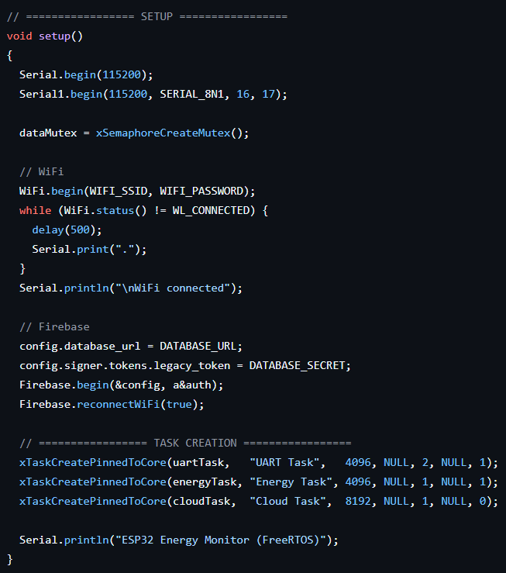
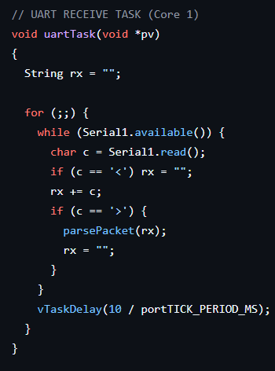
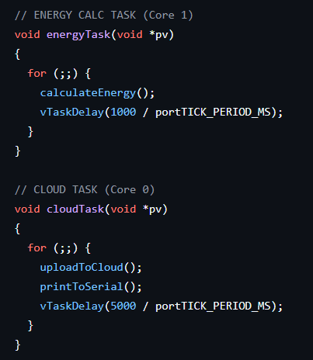
ESP32 Side Code

Slide 11
Tools and Technologies
IAR Embedded Workbench – Embedded C development for STM32
Arduino IDE – ESP32 programming and serial debugging
Firebase Realtime Database – Cloud data storage and visualization
Serial Monitor (UART) – Communication testing and debugging
Mermaid Chart / Eraser.io – Block and architecture diagram design

Slide 12
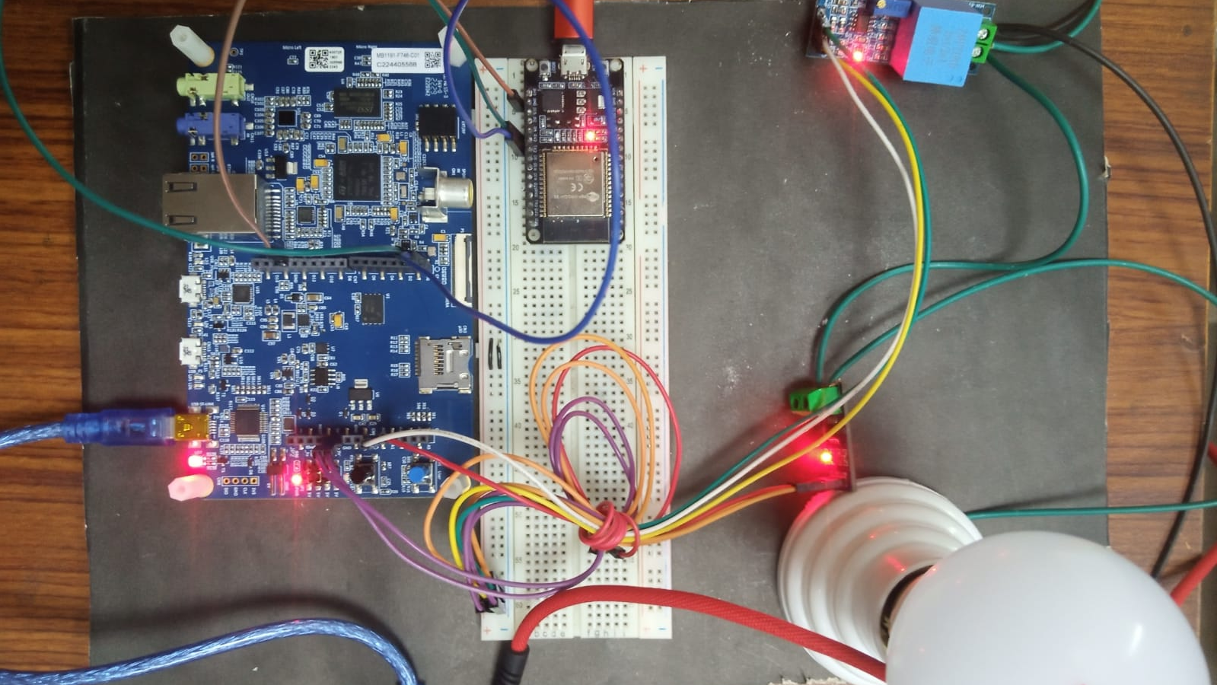
Project
Hardware

Slide 13
Results
Accurate voltage and current measurement
Real-time power and energy tracking
Successful cloud upload to Firebase
Stable system operation

Slide 14
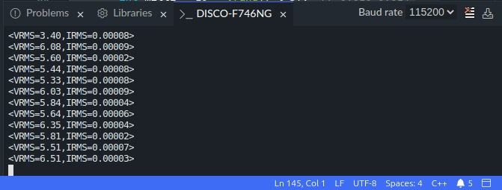
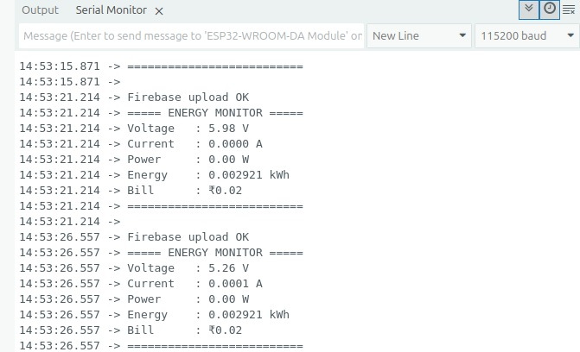
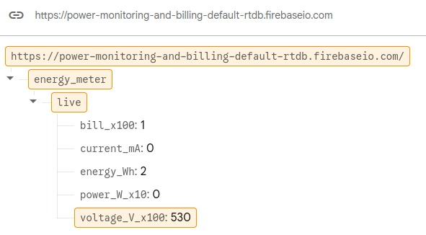
Results contd.
STM32 Side Analysis without load
ESP32 Side Analysis without load
Firebase without load

Slide 15
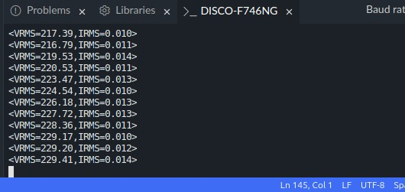
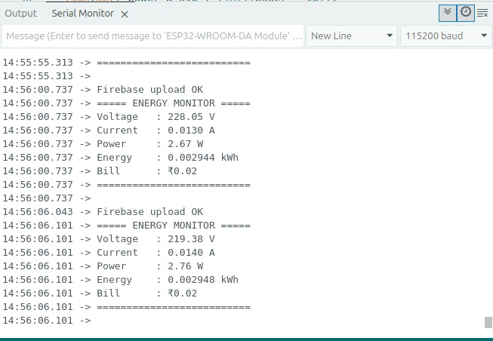
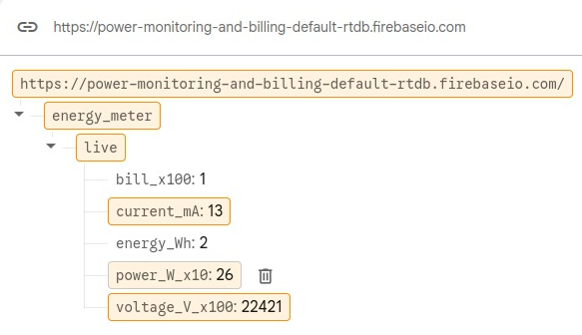
Results contd.
STM32 Side Analysis with load
Firebase with load
ESP32 Side Analysis with load

Slide 16
Applications to Society
Smart home energy monitoring
Industrial power tracking
Utility metering systems
Energy conservation awareness
Reduced energy wastage
Better consumption analysis
Cost-effective monitoring solution

Slide 17
Contribution – Awais Asghar
STM32 ADC configuration
RMS and power calculations
STM32 Programming

Slide 18
Contribution – Muhammad Haris
ESP32 programming
Firebase cloud integration
System Integration

Slide 19
Contribution – Saad Farooq
Circuit design
Circuit Testing
UART communication

Slide 20
Contribution – Aneeq Ur Rehman
Calibration of Sensors
Documentation and Presentation
FreeRTOS

Slide 21
Key Learnings
FreeRTOS task-based embedded design
ADC signal processing
Embedded-to-cloud communication
Real-time system integration

Slide 22
Conclusion
Successfully designed a smart energy monitoring system
Demonstrated real-time cloud-based billing
Project meets embedded system design objectives
Can be extended to smart grid applications

Slide 23

Audience Questions
Any Questions?

Slide 24
Acknowledgments
Dr. Wajid Mumtaz
Mr. Adnan Aslam
EE Department
Teammates

Slide 25

References
STM32F746 Datasheet
ESP32 Documentation
Firebase Realtime Database Docs
Embedded Systems textbooks

